Slide 1
Automated data reduction at ISIS
Anders Markvardsen
ECNS conference Sep 2015

Slide 2

Inspiration

Slide 3
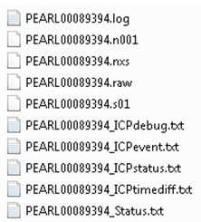
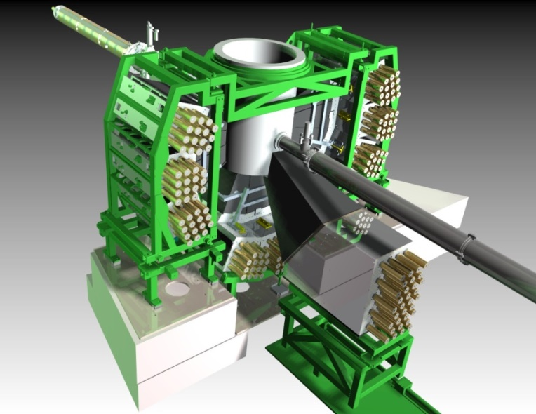


Instrument (Pearl) at ISIS
creates
data
Auto-reduction
Reduced files and reduction logs
data
reduction script

Slide 4
What is the purpose of automation?
Primary aim is to free up instrument scientists and users time
Secondary aim make better use of compute resources
Other: ensure cataloguing of reduced data and/or reduction scripts

Slide 5
Scenario – Automated beamline
Beamline where:
very similar experiments done
users may rarely visit the beamline
The automated service assists the instrument scientists in producing reduced data

Slide 6
Scenario – instrument scientist and user want to go to bed
Instrument scientists and users worked hard at getting experiment setup. Perhaps: adjust various beamline components, fix a broken pump, collected empty sample data, do various scans to check that the sample is anything like it should be etc… until eventually ready to collect useful data but now too tired to sit and watch data coming through and manually reduce these…

Slide 7
User requirements
Most
Must be able to update reduction script
Must be able to access the reduced data and reduction logs
Strong should have
Turn automation on and off
Job queue monitor

Slide 8
User requirements
Most/should/maybe:
Scheduling
Re-run reduction jobs (change variables)
Display of reduction run diagnosis and process to help with debugging failed runs

Slide 9
Auto-reduction
Reduced files and reduction logs
data
reduction script
reduce.py
reduce_vars.py

Slide 10
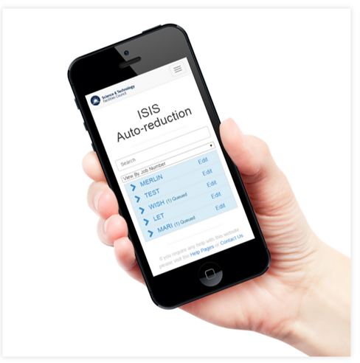
Auto-reduction
Reduced files and reduction logs
data
reduction script

Slide 11
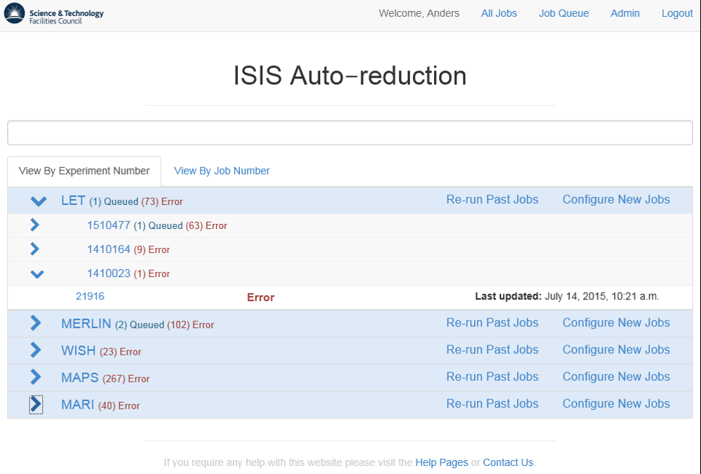

Slide 12
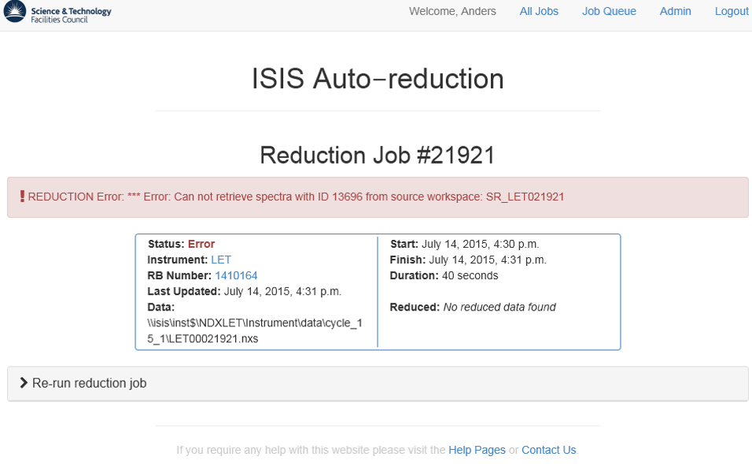

Slide 13
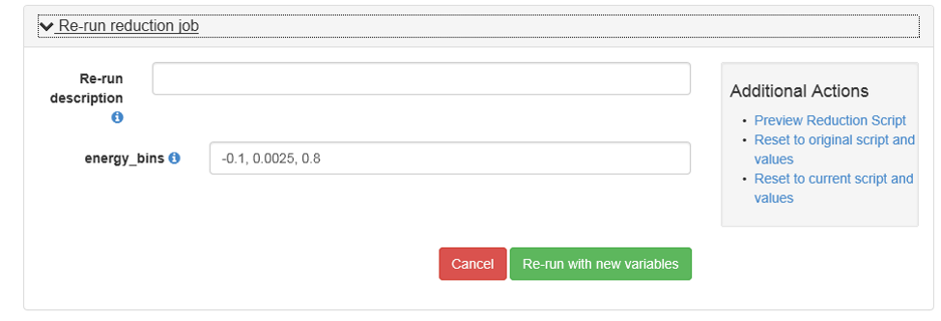

Slide 14
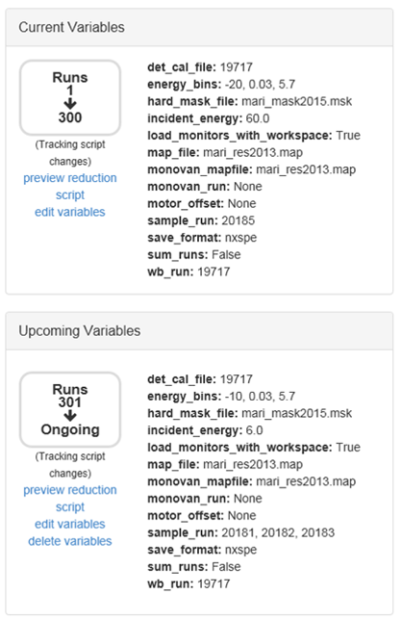

Slide 15
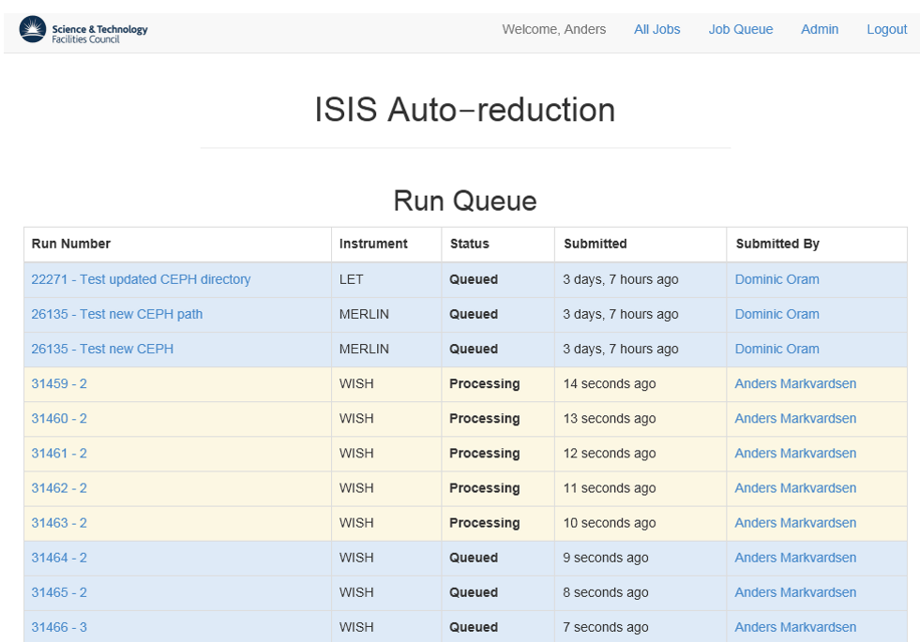
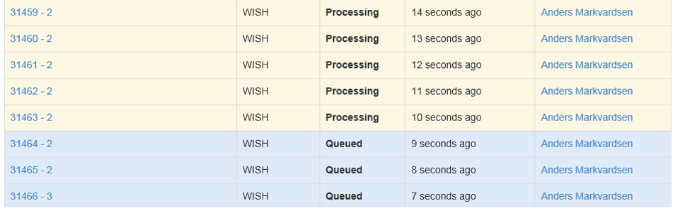


Slide 16
Facility considerations
Permissions?
Store reduced data and/or reduction scripts permanently?
Catalogue reduced data and/or reduction scripts?

Slide 17
https://github.com/mantidproject/autoreduce

Slide 18



Disk monitor
messages
messages
messages
ActiveMQ
Messaging Server
Web interface
Compute
resources

Slide 19
Acknowledgment
Marcus Noble
Lottie Greenwood
Dominic Oram
SNS: Mathieu Doucet and Shelly Ren
Team members: Nick Draper and Martyn Gigg
Computing group: Tom Griffin, Warren Jeffs, Leon Neil
and Chris Moreton-Smith

Slide 20
Thank you

